Slide 1
The South Sea Bubble
Genna Miller
3/14/14
Period 3 - Kinberg

Slide 2
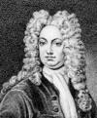
Significant Individuals
Robert Harley (1661-1724) 1st Earl of Oxford and was a senior political figure during the reign of Queen Anne ["Robert Harley, Earl of Oxford“]. Founded the South Sea Company.
Eustace Budgell (1686- 1737) was an English essayist. He lost a fortune of £20,000 in the South Sea Bubble. He later committed suicide [Chopra].

Slide 3
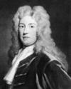
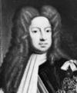
Significant Individuals pt.2
Charles Spencer, 3rd earl of Sunderland (1674-1722) was a British Statesman and one of the Whig ministers who directed the government of King George I [Lotha]. Sunderland then took control of domestic affairs, becoming lord president of the Privy Council and first lord of the Treasury and in 1721 yielded his office to Walpole [Lotha].
Sir Robert Walpole (1676-1745) was a British statesman and is generally known as the first British Prime Minister [Plumb]. Rose to prominence because of his skillful handling of fiscal policy during the South Sea Bubble [Chambers].
King George I (1660-1727) was first Hanoverian king of Great Britain. During the South Sea Bubble scandal, he was forced to give Walpole a free hand in the ministry [Lotha, Shukla].

Slide 4
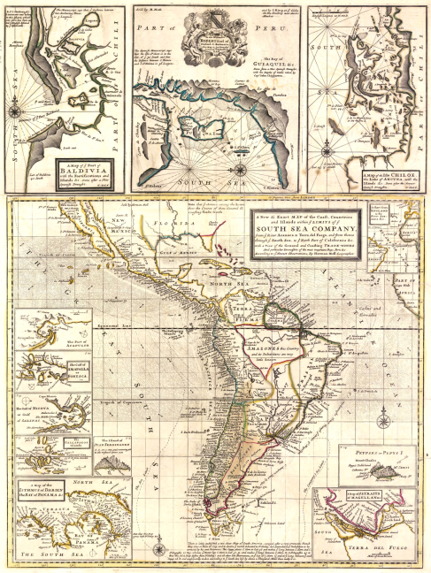
South Sea Company
In 1710, England’s finances were in a dreadful disposition. This led to different government departments to arrange loans and expended money with little financial error [Melissa].
The South Sea Company was founded in1711 by Robert Harley and John Blunt [Colombo]. Robert Harley convinced Parliament and one of the first steps was to reconsider allowing the Bank of England to be handling the loans.
The company was also founded to mainly trade salves with Spanish America. Originally, they thought the War of Spanish Succession would end with a treaty allowing this kind of trade [Singh].

Slide 5
South Sea Company pt. 2
Near the end of the War of Spanish Succession, England had about £10 million of debt it needed to finance [Melissa].
The company promised a monopoly trade to all the Spanish Colonies in South America in exchange for taking over and uniting the national debt raised by the War of Spanish Succession [“South Sea Bubble Short History”].
The South Sea Company thought they would be wealthy because of the monopoly.
However, by 1713, the monopoly of the business was worthless since the Treaty of Utrecht had cut most trade for England in the southern part of the New World [Melissa].
Adding on to what the Treaty did not favor the interest of 6% as it did well before. As a result, the treaty imposed an annual tax on imported slaves and to send one ship a year for general trade [Singh].

Slide 6
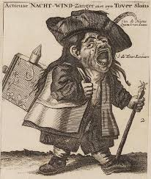
Beginnings of the South Sea Bubble
King George I became the governor of the company in 1718 [Singh].
In 1719, Parliament authorized the South Sea Company to accept an additional portion of the national debt as part of the building of the war debt conversion since 1711[“South Sea Bubble Short History”]. In other words, the company should have responsibility of the debt.
The government accepted this proposal, and the result was an incredible wave of speculation, which drove the price of the company's stock from £1281/2 in Jan., 1720, to £1,000 in August [“South Sea Bubble”].

Slide 7
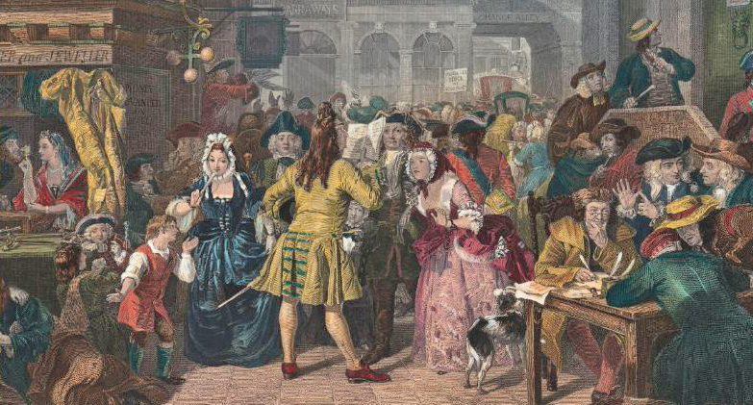
The South Sea Bubble
By September of 1720, the market had collapsed. By December of that year, shares were down to 124. Investors were ruined, the House of Commons ordered an investigation, and many company’s directors were humiliated [Singh].
Banks failed when they could not collects loan on inflated stock, prices of stock fell, and fraud in the company was well known [“South Sea Bubble”].
This crash, known as the South Sea Bubble, resembled the failure of John Law’s similar scheme in France, but it has less effect on government finances [Chambers].

Slide 8
The South Sea Bubble pt.2
Sir Robert Walpole ascended to power, with power like a Prime Minister’s, in 1721. Originally, he favored letting the Bank of England be in charge of the debt, he knew people heavily invested in the South Sea Stock [Plumb].
Walpole promised to look for those responsible for the scandal, but only sacrificed some that were involved in order to keep the reputation of government’s leaders [Singh].

Slide 9
The Bubble Act
The Bubble Act was made in June of 1720 and required all Joint-Stock companies to receive a Royal Charter. This was introduced by the South Sea Company. By the end of June their share price had rose to £1050 [“South Sea Bubble Short History”].

Slide 10
Works Cited (Pictures)
1720 Herman Moll Map of South America (South Sea Company). 1720. Geographicus Rare Antique Maps. 17 Mar. 2014 <http://www.geographicus.com/P/AntiqueMap/SouthSeaCom pany-moll-1720>.
Charles Spencer, 3rd earl of Sunderland (British statesman). Encyclopedia Britannica Online. By The Editors of Encyclopædia Britannica. Encyclopedia Britannica. 17 Mar. 2014<http://www.britannica.com/EBchecked/topic/573814/Ch arles-Spencer-3rd- earl-of-Sunderland>.
Eustace Budgell (English author). Encyclopedia Britannica Online. By The Editors of Encyclopædia Britannica. Encyclopedia Britannica. 17 Mar. 2014 <http://www.britannica.com/EBchecked/topic/83449/Eustace- Budgell>.
George I (king of Great Britain). Encyclopedia Britannica Online. By The Editors of Encyclopædia Britannica. Encyclopedia Britannica. 17 Mar. 2014 <http://www.britannica.com/EBchecked/topic/229982/George-I>.
Robert Harley, 1st earl of Oxford (English statesman). Encyclopedia Britannica Online. By John S. Morrill. Encyclopedia Britannica. 17 Mar. 2014 <http://www.britannica.com/EBchecked/topic/436482/Robert-Harley-1st-earl-of- Oxford>.
Robert Walpole, 1st earl of Orford (prime minister of Great Britain). Encyclopedia Britannica Online. By Sir John Plumb. Encyclopedia Britannica. 17 Mar. 2014 <http://www.britannica.com/EBchecked/topic/635013/Robert-Walpole-1st-earl-of- Orford>.
The South Sea Bubble, a Scene in 'Change Alley in 1720. 1847. BBC News. By Edward Matthew Ward. BBC. 17 Mar. 2014 <http://www.bbc.co.uk/arts/yourpaintings/paintings/the- south-sea-bubble-a- scene-in-change-alley-in-1720-202698>.
Tag Archives: Pump and Dump. 1720. Csinvesting. 17 Mar. 2014 <http://csinvesting.org/tag/pump-and-dump/>.

Slide 11
Works Cited
Chambers, Mortimer. The Western Experience, 9th Edition. San Francisco: McGraw Hill, 2007. Print.
Chopra, Swati. "Eustace Budgell (English Author)." Encyclopedia Britannica Online. Encyclopedia Britannica, n.d. Web. 16 Mar. 2014.
Colombo, Jesse. "The South Sea Bubble." RSS. N.p., 18 May 2012. Web. 14 Mar. 2014.
Lotha, Gloria, and Gaurav Shukla. "George I (king of Great Britain)." Encyclopedia Britannica Online. Encyclopedia Britannica, n.d. Web. 16 Mar. 2014.
Lotha, Gloria. "Charles Spencer, 3rd Earl of Sunderland (British Statesman)." Encyclopedia Britannica Online. Encyclopedia Britannica, n.d. Web. 16 Mar. 2014.
Melissa. "The First Stock Market Crash: The South Sea Company." Today I Found Out RSS. Vacca Foeda Media, 25 Apr. 2013. Web. 14 Mar. 2014.
Plumb, Sir John. "Robert Walpole, 1st Earl of Orford (prime Minister of Great Britain)." Encyclopedia Britannica Online. Encyclopedia Britannica, n.d. Web. 15 Mar. 2014.
"Robert Harley, Earl of Oxford." Robert Harley, Earl of Oxford. N.p., n.d. Web. 15 Mar. 2014.
Singh, Shiveta. "South Sea Bubble (British History)." Encyclopedia Britannica Online. Encyclopedia Britannica, n.d. Web. 15 Mar. 2014.
"South Sea Bubble." Infoplease. Infoplease, n.d. Web. 15 Mar. 2014.
"South Sea Bubble Short History." – Baker Library. President and Fellows of Harvard College, 2010. Web. 14 Mar. 2014.

